Slide 1
White House grade proactive anti-virus air purification solution
IWT Global Limited

Slide 2
01
Why RGF-inside ?
for anti-virus air purification
02
How RGF PHI works?
Technology fundamentals
CONTENT
03
Certification & Job Reference
How reliable? Who are using RGF?
04
Existing product line
Personal, Household, Living Room
Commercial HVAC

Slide 3
01 Why RGF?
White House Grade Air Purification Technology

Slide 4
Who & Why RGF?
01
02
Founded in 1985
Patented Technology PHI®
Headquarters in Palm Spring, Florida
30 years+ experience in Environmental Science
Photohydroionization to generate friendly oxidizer ions to actively kill gems & viruses
03
04
Filterless. Proactively kill viruses
Trusted by USA Government
P4 lab test reports validates reliability
Only product all certified by the Government of USA, China and Taiwan
Dept of Defense, NASA, White House
Dept of Homeland Security
05
06
Direct Challenge of SARS
Localized version: PICT
1000 sets installation in Beijing 小湯山 hospitals in 2003. Field combat SARS virus inactivation rate 73%+
Developed by Taiwan/Hong Kong team for better price performance ratio, more readily available

Slide 5
Patented PHI Technology
Photohydroionization® (PHI) is an advanced oxidation technology developed by RGF Environmental Group to minimize and neutralize indoor air pollutants such as bacteria, viruses, mold, gases (VOCs) and odours.
PHI utilizes a broad-spectrum, high intensity UV light targeted on a hydrated quad-metallic catalyst surface. This target surface is covered with a proprietary quad-metallic and hydrophilic coating.
The UV light reacts with the catalyst and moisture to produce an advanced oxidation plasma consisting of hydro-peroxides, super oxide ions and hydroxide ions. These friendly oxidizers will revert back to oxygen and hydrogen once they’ve come in contact with and eliminated the pollutant.
PHI REME® further improve the killing rate of PHI and handling of PM2.5 particles.
RGF is not medical device, and this presentation is not making medial claims
Notes:
數據顯示公司現時困境的實況

Slide 6
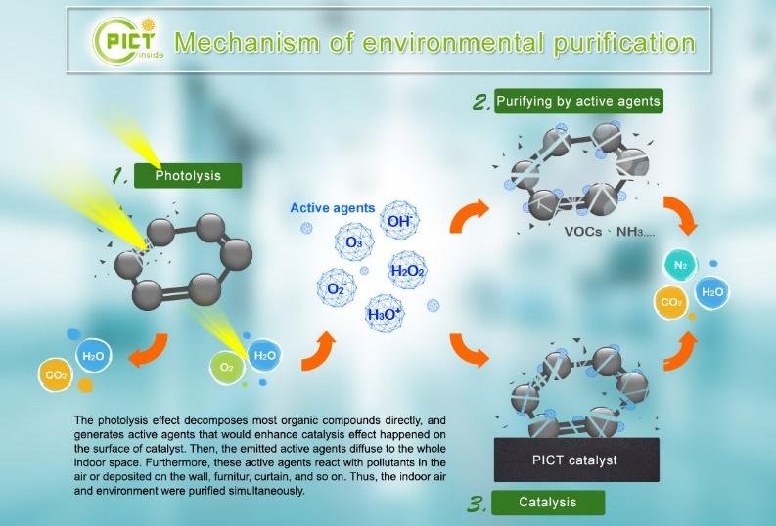
Localized version of PHI technology: PICT®
Photo Ion Catalysis Technology is one of AOP (Advanced Oxidation Process) technology. PICT LED tube emits UVC (100~280nm) ultraviolet to kill gems & virus, and part of light (<200nm) ionized H₂O and O₂ in the air to create H₂O₂, O₃, H₃O+, OH-, O₂- friendly oxidizer ions to proactively clean air and to kill viruses, including coronavirus.
Based on PHI technology, RGF Taiwan Local Partner localize the technology by using Taiwan components to achieve same result.
PICT is not medical device, and this presentation is not making medial claims
Notes:
數據顯示公司現時困境的實況

Slide 7
03 Lab Test Report & Job Reference
By National Bio and Agro-Defense Facility (NBAF), Kansas State University

Slide 8
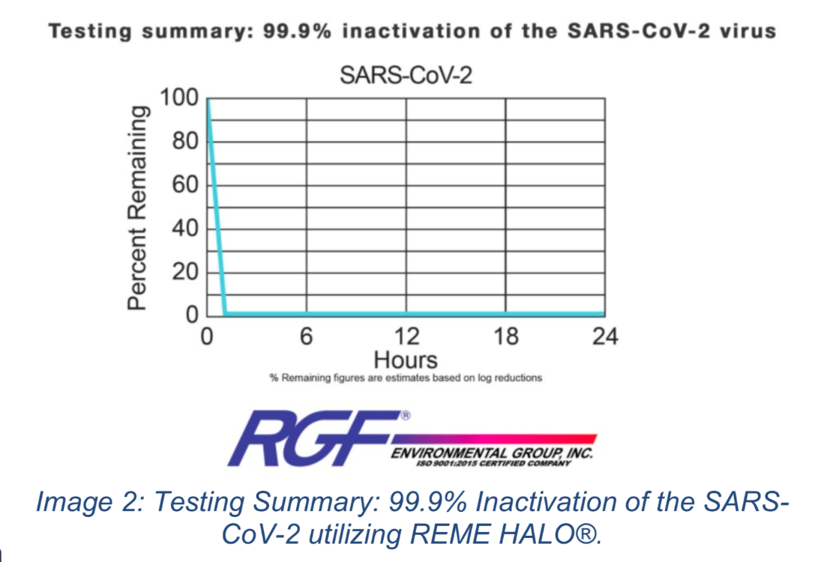
99.9% reduction of SARS-Cov-2 virus
By Innovative Bioanalysis Laboratories in Cypress, Calif.
Such tests cannot be conducted by SGS or similar certification lab.
The test procedure used the SARS-CoV-2 virus inside a large chamber (1,280 cu. ft.) representing a real-world air-conditioned office or home. The virus was nebulized into the space simulating a sneeze or cough from an infected person. With the REME HALO® operating inside the chamber the virus was reduced on contact, resulting in a 99.9% reduction of the virus within the simulated real-world space.
All test result are open to public
https://www.rgf.com/rgf-environmental-group-study-reme-halo-inactivates-sars-cov-2-by-99-9/
Notes:
數據顯示公司現時困境的實況

Slide 9
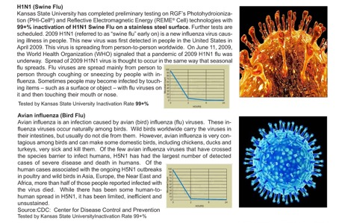
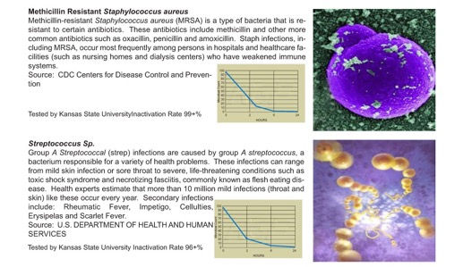
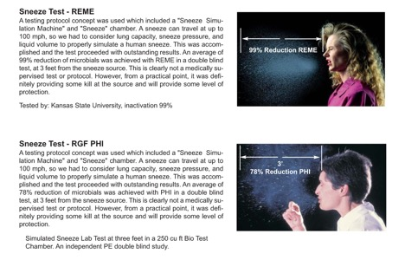
Advanced Oxidation Test Results
By National Bio and Agro-Defense Facility (NBAF), Kansas State University. The real P4 grade lab.
Such tests cannot be conducted by SGS or similar certification lab.
4-log reduction (99.99%) surface bacterial/virus reduction
All test reports are open to public
https://www.rgf.com/test-results/
Notes:
數據顯示公司現時困境的實況

Slide 10
Sneeze Simulation Test
A testing protocol concept was used which included a “Sneeze Simulation Machine” and “Sneeze” chamber. A sneeze can travel at up to 100 mph, so lung capacity, sneeze pressure, and liquid volume had to be taken into consideration to properly simulate a human sneeze. This was accomplished and the test proceeded with outstanding results. An average of 99% reduction of sneeze germs was achieved with PHI/ REME® in a double-blind test, at 3 feet from the sneeze source.

Slide 11
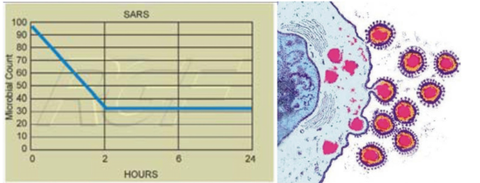
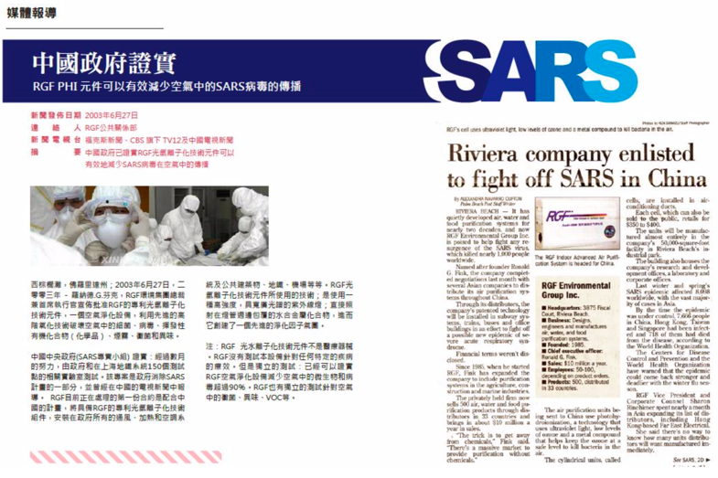
Direct Confrontation with SARS
The only technology that has directly experience to battle with SARS in 2003. Inactivation rate 73% in 2 hours (lab test by CDC USA)
2019 Novel Corona Pneumonia (NCP) and SARS are regarded as the same category of Coronavirus.

Slide 12
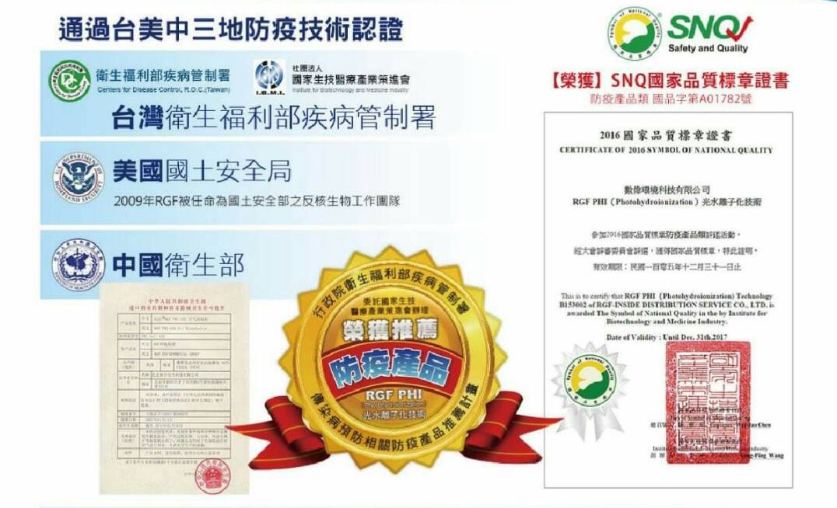
Triple Certifications: USA, China & Taiwan

Slide 13
Certified by California Air Resource Board
To be certified, air cleaners must be tested for electrical safety and ozone emissions, and meet an ozone emission concentration limit of 0.050 parts per million.
https://ww2.arb.ca.gov/our-work/programs/air-cleaners-ozone-products/california-certified-air-cleaning-devices

Slide 14
Job References: President of USA
RGF-inside® air purification system was the mandatory requirements stated by the White House for hotels to host President Obama
Beijing Jinmao Westin Hotel
Beijing International Club Hotel (now St. Regis Hotel)

Slide 15
Job References: Top-tiers & Fortune 500

Slide 16
Job References: Hospital

Slide 17
Product Line-up
2020 Q2

Slide 18
Hot Item: RGF-Inside R1S
Model : RGF-Inside R1S / R1S2
Coverage: 700 / 1080 sq. ft
Technology: PHI® REME
Dimension: 18.0cm diameter x 35cm height
Power: DC 12V 12W
Material: UV-proof ABS plastic and metallic chassis
Fan: Maglev (full speed for 5 minutes upon power up, ultra silent mode afterwards)
Availability: In Stock Taipei (while stock lasts)
Weight: 3.2kg
Warranty: 1 year
Application: Living Room / Conference Room / Classroom
Notes:
不为失败找藉口，只是以事论事。

Slide 19
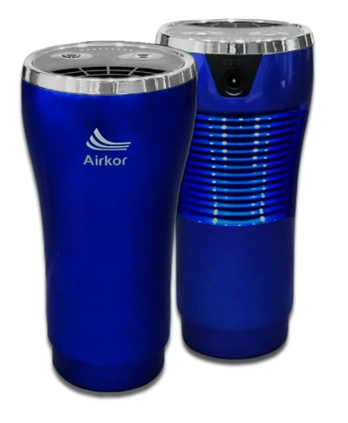
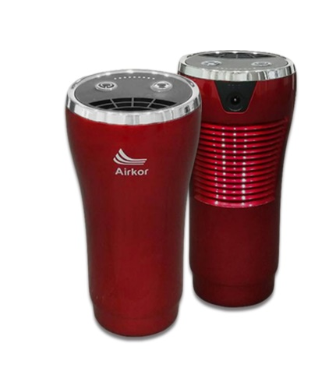
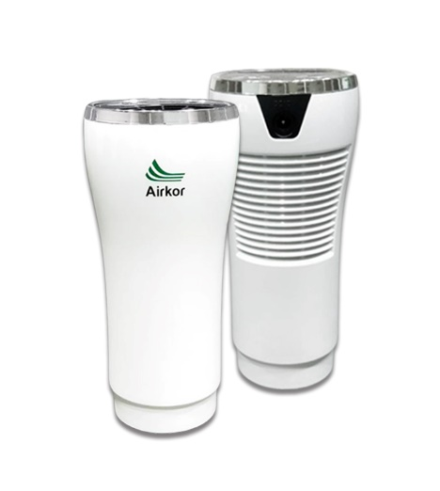
Hot Item: RGF-Inside A5
Model : RGF-Inside A5
Coverage: 735 sq. ft
Technology: PHI® REME
Dimension: 78 x 60 x 162mm
Power: DC 12V 20W
Material: UV-proof ABS plastic
Fan: Maglev (full speed for 5 minutes upon power up, ultra silent mode afterwards)
Availability: In Stock Taipei (while stock lasts)
Weight: 360g
Warranty: 1 year
Application: mid-size living room, bedroom, in-car, bathroom, small office
Notes:
不为失败找藉口，只是以事论事。

Slide 20
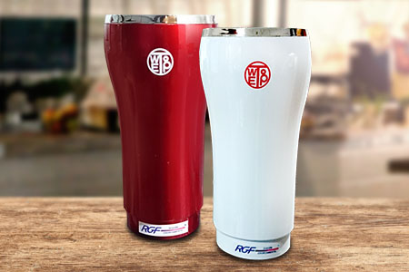
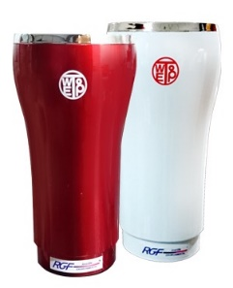
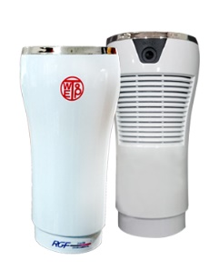
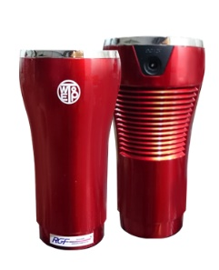
Hot Item：C170
Model : RGF-Inside C170 (UK/HK Special)
Coverage: 605 sq. ft
Technology: RGF PHI®
Dimension: 80 x 80 x 150mm
Input: DC 12V 20W
Chassis：UV-proof ABS Plastic
Fan：Maglev fan (full speed, require button push on power up)
Weight: 350g
Life span：25,000 hours non-stop operation (approx. 3 years)
Consumable: nil
Warranty: 1-year carry-in
Use case: Bedroom, small living room, manager room, reception counter
Certification：CCC, BSMI

Slide 21
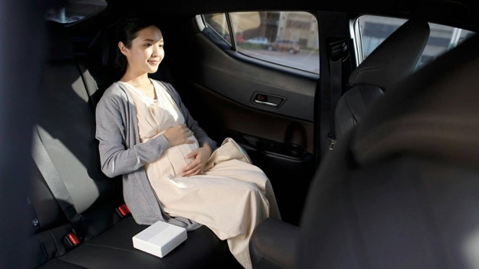
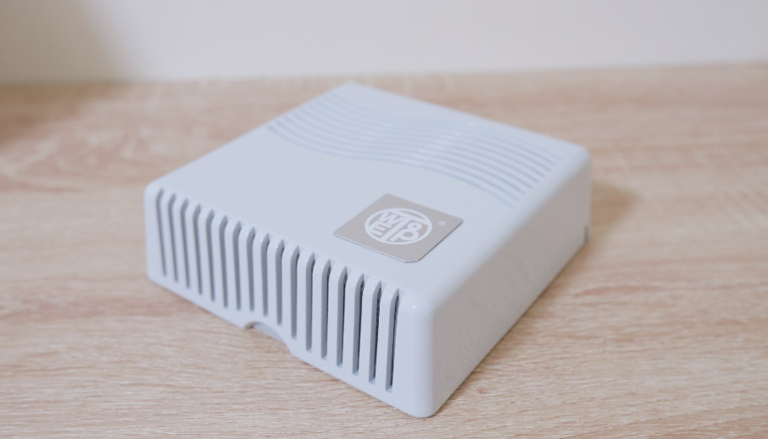
Upcoming：Purarea Series
Model : Purarea Model 1
Coverage : 215 sq. ft
Technology : PICT® Inside
Dimension: 120 x 120 x 38 mm
Input: Micro USB 5V
Fan：Maglev fan always-on silent mode
Chassis：UV-proof ABS Plastic
LED Status Light
Self-serviceable stainless-steel filter screen
Weight: to be confirmed
Use case: personal worktop, small bedroom, washroom, small lift, hand-carry on bus/metro
(Expected to be out by End of August 2020)

Slide 22
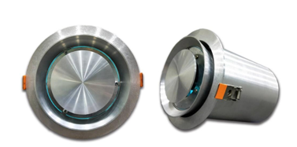
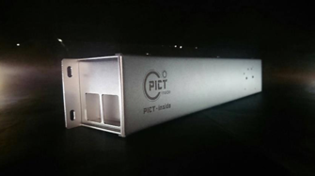
Industrial Products Highlight
Model : RGF-Inside DLL1R
Coverage: 20~70 m³
Technology: PHI REME
Dimension: Dia 150mm, 220mm length
Power: 100V~240V 9W
Material: Metallic
Weight: 1.35kg
Warranty: 1 year
Application: office, retail shops, clinic
Model : PICT-Inside DML1R
Coverage: 20~70 m³
Technology: RGF PHI
Dimension: 66 x 66 x 390mm
Power: 100V~240V 9W
Material: Metallic
Weight: 670g
Warranty: 1 year
Application: small office, lift, clinic, classroom
Model : PICT-Inside DML1R
Coverage: 60~100 m³
Technology: RGF PHI
Dimension: 66 x 66 x 390mm
Power: 100V~240V 10W
Material: Metallic
Weight: 670g
Warranty: 1 year
Application: small office, lift, clinic, classroom
Notes:
不为失败找藉口，只是以事论事。

Slide 23
10 Reasons to adopt RGF PHI/PICT
Proven efficacy 99.9% on SARS-Cov-2 by third-party independent lab
Neutralize deadly viruses, and result in H₂O, O₂ and other harmless materials
Significant reduction the risk of infection, range from 73% to 99.9%. Albeit inactivation rate is not 100%, still very profitable for baby, young children and elderlies
Proven technology from USA, tested by P4 lab in Kansas and CDC. Certified by Health Department of China and Taiwan
Trusted by White House, US Army/Navy/Airforce, Homeland Security Department
Field testimonials from SARS frontier
Trusted by Fortune 500 and other impressive client lists
Easy to install, truly plug-and-play. No huge ventilation fan. Low noise level and power-saving
Durable, non-stop operation of 25,000 hours. No moving parts, no filter, zero maintenance, no costly filter replacement
Very High Return on Investment, especially during Covid-19 pandemic
Notes:
不为失败找藉口，只是以事论事。

Slide 24
Thank you for your attention

